Slide 1
Big O

Slide 2

What is Big O?

Slide 3



What is Big O?
Big O is the language and metric we use to describe the efficiency of algorithms.
Internet
?
Size : 1TB
Time Complexity : A way of showing how the runtime of a function increases as the size of input increases.

Slide 4
What is Big O?
Big O is the language and metric we use to describe the efficiency of algorithms.
Electronic - O(s)
Physical - O(1)
Time Complexity : A way of showing how the runtime of a function increases as the size of input increases.

Slide 5

What is Big O?
Types of Runtimes: O(N), O(N²), O(2^{N})
w
^{h} Time complexity : O(wh)

Slide 6

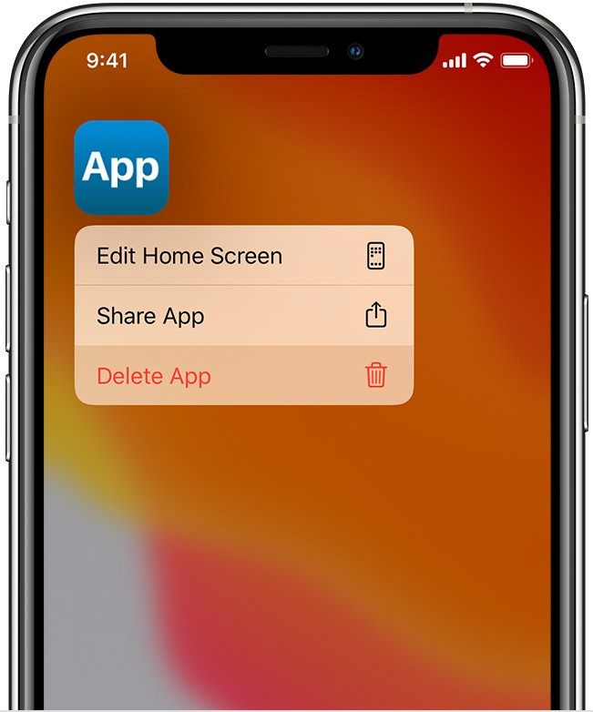
What is Big O?

Slide 7
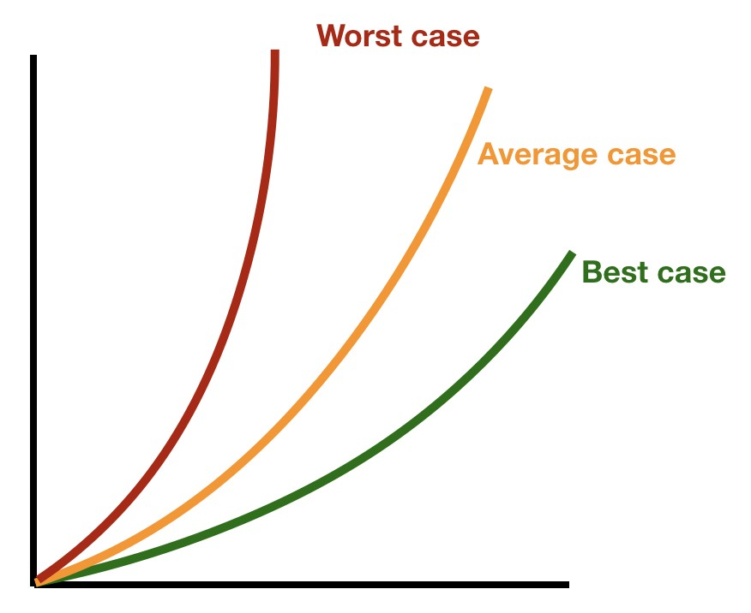
Big O Notations

Slide 8

Big O Notations
City traffic - 20 liters
Highway - 10 liters
Mixed condition - 15 liters

Slide 9
Big O Notations
Best case
Average case
Worst case

Slide 10
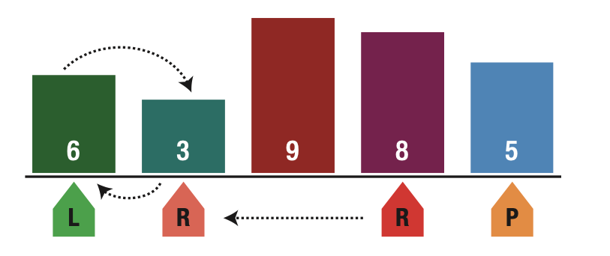
Big O Notations
O(N²)
Quick sort algorithm
O(N log N)
O(N)

Slide 11
Big O Notations
Big O : It is a complexity that is going to be less or equal to the worst case.
Big - Ω (Big-Omega) : It is a complexity that is going to be at least more than the best case.
Big Theta (Big - Θ) : It is a complexity that is within bounds of the worst and the best cases.
n
5 | 4 | 10 | … | 8 | 11 | 68 | 87 | 12 | … | 90 | 13 | 77 | 55 | 9
Big O - O(N)
Big Ω - Ω(1)
Big Θ - Θ(n/2)

Slide 12
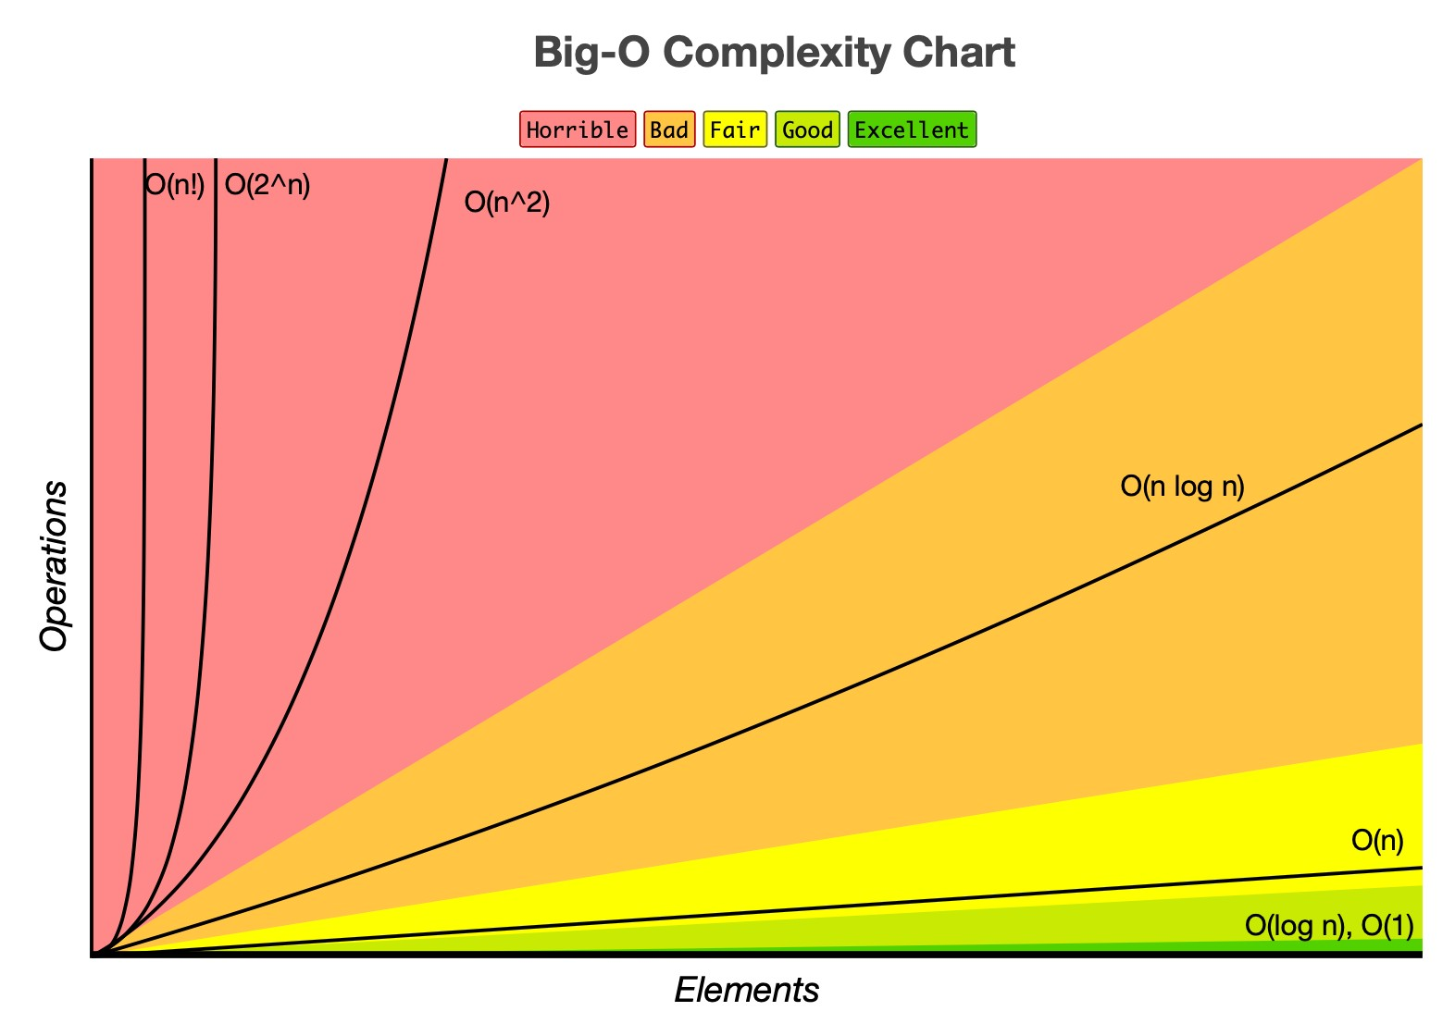
Runtime Complexities

Slide 13
Runtime Complexities
Complexity | Name | Sample
O(1) | Constant | Accessing a specific element in array
O(N) | Linear | Loop through array elements
O(LogN) | Logarithmic | Find an element in sorted array
O(N²) | Quadratic | Looking ar a every index in the array twice
O(2^{N}) | Exponential | Double recursion in Fibonacci
O(1) - Constant time
int[] array = {1, 2, 3, 4, 5}
array[0] // It takes constant time to access first element

Slide 14
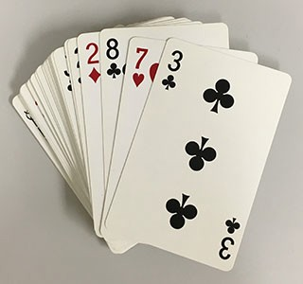

Runtime Complexities
Complexity | Name | Sample
O(1) | Constant | Accessing a specific element in array
O(N) | Linear | Loop through array elements
O(LogN) | Logarithmic | Find an element in sorted array
O(N²) | Quadratic | Looking ar a every index in the array twice
O(2^{N}) | Exponential | Double recursion in Fibonacci
O(1) - Constant time
random card

Slide 15
Runtime Complexities
Complexity | Name | Sample
O(1) | Constant | Accessing a specific element in array
O(N) | Linear | Loop through array elements
O(LogN) | Logarithmic | Find an element in sorted array
O(N²) | Quadratic | Looking ar a every index in the array twice
O(2^{N}) | Exponential | Double recursion in Fibonacci
O(N) - Linear time
int[] custArray = {1, 2, 3, 4, 5}
for (int i = 0; i < custArray.length; i++) { System.out.println(custArray[i]);
}
//linear time since it is visiting every element of array

Slide 16

Runtime Complexities
Complexity | Name | Sample
O(1) | Constant | Accessing a specific element in array
O(N) | Linear | Loop through array elements
O(LogN) | Logarithmic | Find an element in sorted array
O(N²) | Quadratic | Looking ar a every index in the array twice
O(2^{N}) | Exponential | Double recursion in Fibonacci
O(N) - Linear time
Specific card

Slide 17
Runtime Complexities
Complexity | Name | Sample
O(1) | Constant | Accessing a specific element in array
O(N) | Linear | Loop through array elements
O(LogN) | Logarithmic | Find an element in sorted array
O(N²) | Quadratic | Looking ar a every index in the array twice
O(2^{N}) | Exponential | Double recursion in Fibonacci
O(Log N) - Logarithmic time
int[] custArray = {1, 2, 3, 4, 5}
for (int i = 0; i < custArray.length; i+3) { System.out.println(custArray[i]);
}
//logarithmic time since it is visiting only some elements

Slide 18
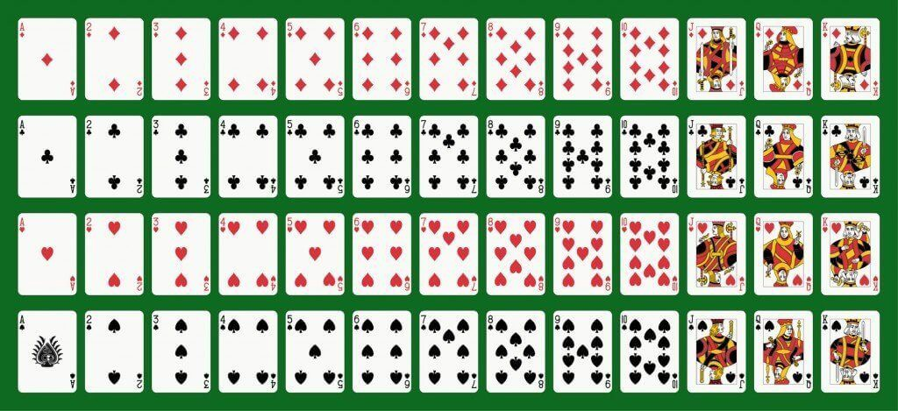
Runtime Complexities
Complexity | Name | Sample
O(1) | Constant | Accessing a specific element in array
O(N) | Linear | Loop through array elements
O(LogN) | Logarithmic | Find an element in sorted array
O(N²) | Quadratic | Looking ar a every index in the array twice
O(2^{N}) | Exponential | Double recursion in Fibonacci
O(Log N) - Logarithmic time

Slide 19
Runtime Complexities
Complexity | Name | Sample
O(1) | Constant | Accessing a specific element in array
O(N) | Linear | Loop through array elements
O(LogN) | Logarithmic | Find an element in sorted array
O(N²) | Quadratic | Looking ar a every index in the array twice
O(2^{N}) | Exponential | Double recursion in Fibonacci
O(Log N) - Logarithmic time
Binary search
search 9 within [1,5,8,9,11,13,15,19,21]
compare 9 to 11 → smaller
search 9 within [1,5,8,9]
compare 9 to 8 → bigger
search 9 within [9]
compare 9 to 9 return
N | = | 16
N | = | 8 | /* | divide | by | 2 | */
N | = | 4 | /* | divide | by | 2 | */
N | = | 2 | /* | divide | by | 2 | */
N | = | 1 | /* | divide | by | 2 | */
2^{k} = N → log2N = k

Slide 20
Runtime Complexities
Complexity | Name | Sample
O(1) | Constant | Accessing a specific element in array
O(N) | Linear | Loop through array elements
O(LogN) | Logarithmic | Find an element in sorted array
O(N²) | Quadratic | Looking ar a every index in the array twice
O(2^{N}) | Exponential | Double recursion in Fibonacci
O(N²) - Quadratic time
int[] custArray = {1, 2, 3, 4, 5}
for (int i = 0; i < custArray.length; i++) { for (int j = 0; j < custArray.length; j++) {
System.out.println(custArray[i]);
}
}

Slide 21
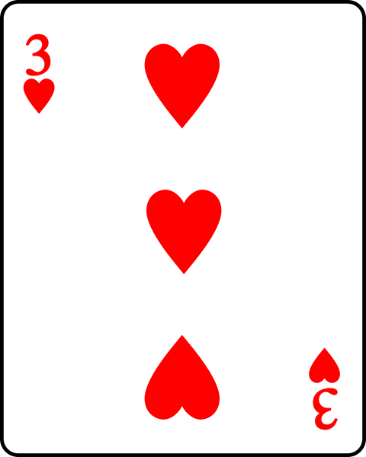
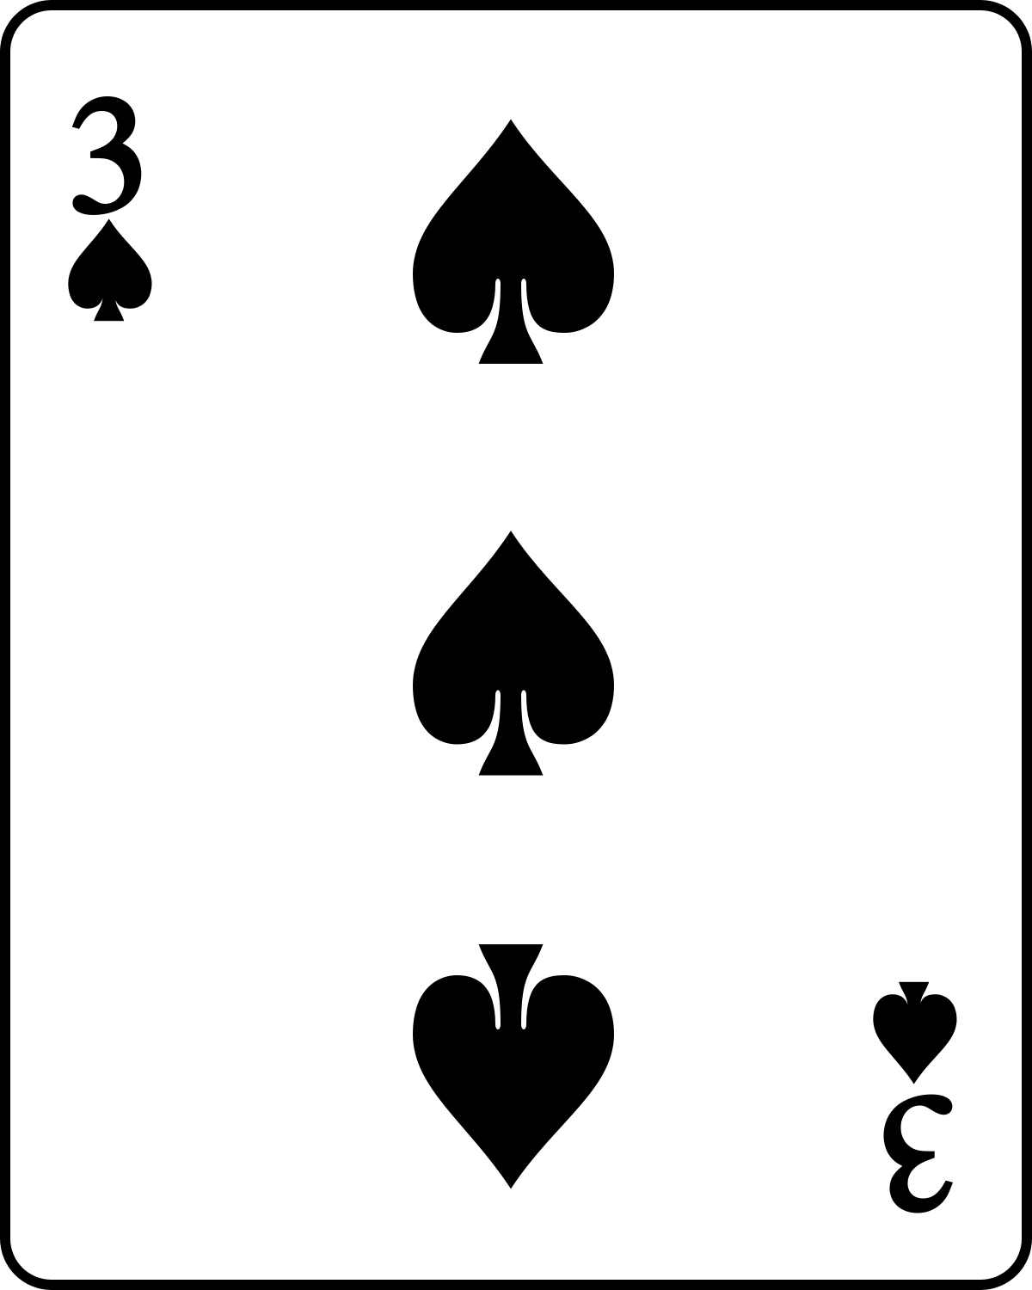
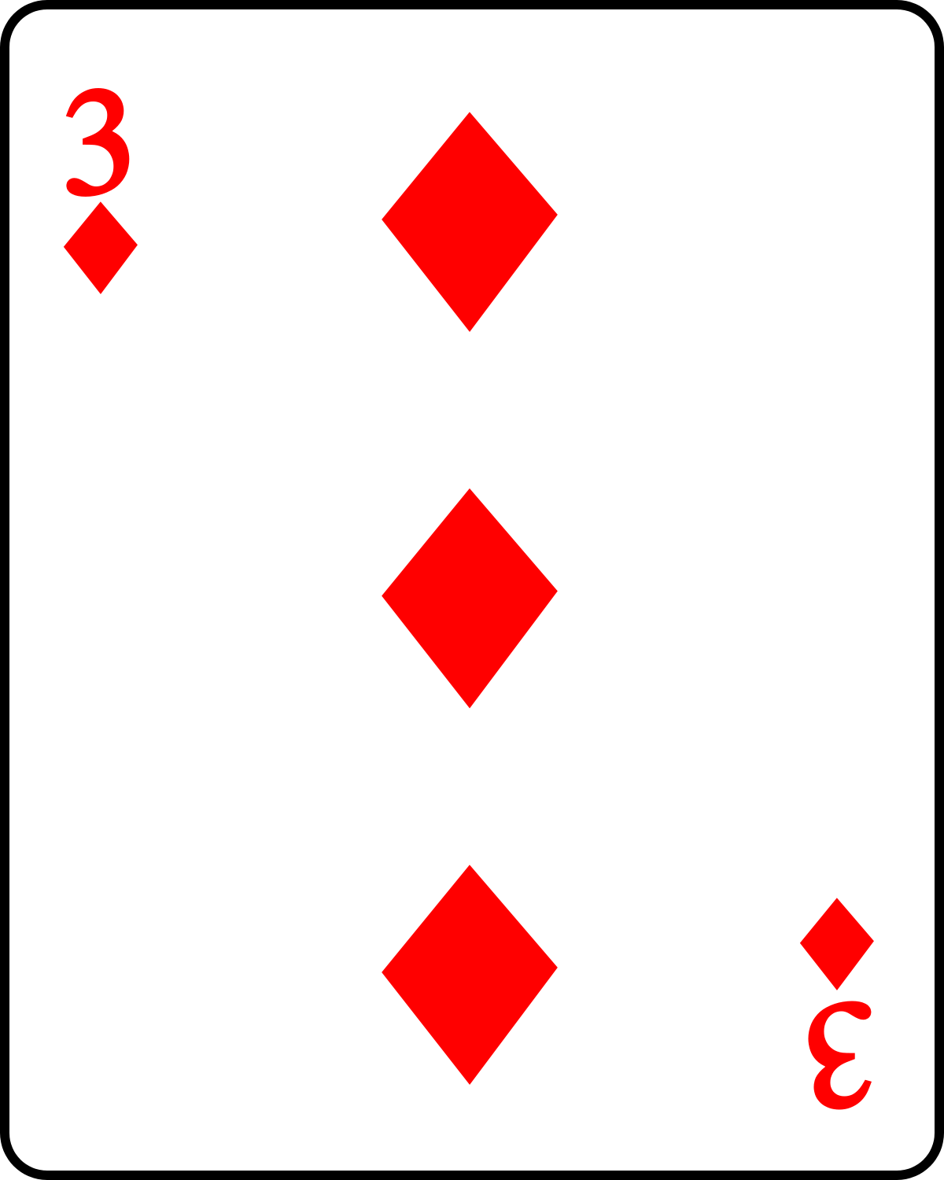
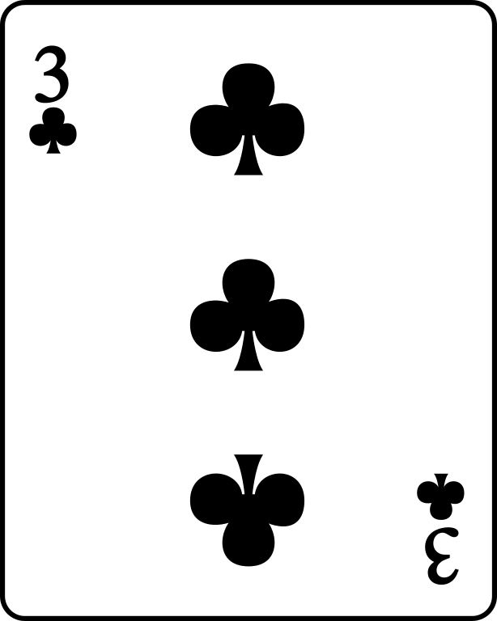
Runtime Complexities
Complexity | Name | Sample
O(1) | Constant | Accessing a specific element in array
O(N) | Linear | Loop through array elements
O(LogN) | Logarithmic | Find an element in sorted array
O(N²) | Quadratic | Looking ar a every index in the array twice
O(2^{N}) | Exponential | Double recursion in Fibonacci
O(N²) - Quadratic time

Slide 22
Runtime Complexities
Complexity | Name | Sample
O(1) | Constant | Accessing a specific element in array
O(N) | Linear | Loop through array elements
O(LogN) | Logarithmic | Find an element in sorted array
O(N²) | Quadratic | Looking ar a every index in the array twice
O(2^{N}) | Exponential | Double recursion in Fibonacci
O(2^{N}) - Exponential time
public int fibonacci(int n) {
if (n==0 || n==1) { return n;
}
return fibonacci(n-1) + fibonacci(n-2);
}

Slide 23
Runtime Complexities

Slide 24
Space Complexity

Slide 25
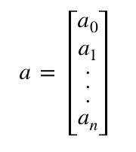
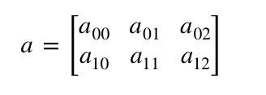
Space Complexity
an array of size n
an array of size n*n
O(n)
O(n²)

Slide 26
Space Complexity
static int sum(int n) {
if (n <= 0) {
return 0;
}
return n + sum(n-1);
}
1 sum(3)
2 → sum(2)
3 → sum(1)
4 → sum(0)
Space complexity : O(n)

Slide 27
Space Complexity
static int pairSumSequence(int n) { var sum = 0;
for (int i = 0; i <= n; i++) {
sum = sum + pairSum(i, i+1);
}
return sum;
}
static int pairSum(int a, int b) {
return a + b;
}
Space complexity : O(1)

Slide 28
Drop Constants and Non Dominant Terms

Slide 29
Drop Constants and Non Dominant Terms
Drop Constant
O(2N)
O(N)
Drop Non Dominant Terms
O(N²+N) O(N²)
O(N+logN) O(N)
O(2*2^{N}+1000N¹⁰⁰) O(2^{N})

Slide 30


Drop Constants and Non Dominant Terms
It is very possible that O(N) code is faster than O(1) code for specific inputs
Different computers with different architectures have different constant factors.
Fast computer Fast memory access
Lower constant
Slow computer Slow memory access
Higher constant
Different algorithms with the same basic idea and computational complexity might have slightly different constants
Example: a*(b-c) vs a*b - a*c
As 𝑛→∞, constant factors are not really a big deal

Slide 31


Add vs Multiply
for (a=0; arrayA.length; a++) { System.out.println(arrayA[a]);
}
for (b=0; arrayB.length; b++) { System.out.println(arrayB[b]);
}
for (a=0; arrayA.length; a++) {
for (b=0; arrayB.length; b++) { System.out.println(arrayB[b] + arrayA[a]);
}
}
Add the Runtimes: O(A + B)
Multiply the Runtimes: O(A * B)
If your algorithm is in the form “do this, then when you are all done, do that” then you add the runtimes.
If your algorithm is in the form “do this for each time you do that” then you multiply the runtimes.

Slide 32
How to measure the codes using Big O?

Slide 33
How to measure the codes using Big O?
No | Description | Complexity
Rule 1 | Any assignment statements and if statements that are executed once regardless of the size of the problem | O(1)
Rule 2 | A simple “for” loop from 0 to n ( with no internal loops) | O(n)
Rule 3 | A nested loop of the same type takes quadratic time complexity | O(n²)
Rule 4 | A loop, in which the controlling parameter is divided by two at each step | O(log n)
Rule 5 | When dealing with multiple statements, just add them up
sampleArray
5 | 4 | 10 | … | 8 | 11 | 68 | 87 | …
Public static void findBiggestNumber([] sampleArray) { var biggestNumber = sampleArray[0];
for (index=1; sampleArray.length; index++) {
if (sampleArray[index] > biggestNumber) { biggestNumber = sampleArray[index];
}
}
System.out.println(biggestNumber);
}
}
O(1)
O(n)
O(1)
}
O(n)
O(1)
O(1)
O(1)
Time complexity : O(1) + O(n) + O(1) = O(n)

Slide 34
How to measure Recursive Algorithm?

Slide 35
How to measure Recursive Algorithm?
sampleArray
5 | 4 | 10 | … | 8 | 11 | 68 | 87 | 10
public int findMaxNumRec(int [] sampleArray, int n): if (n == 1) {
return sampleArray[0];
}
return max(sampleArray[n-1],findMaxNumRec(sampleArray, n-1));
Explanation:
A =
11 | 4 | 12 | 7
n = 4
findMaxNumRec(A,4)
max(A[4-1],12)
max(7,12)=12
findMaxNumRec(A,3)
max(A[3-1],11)
max(12,11)=12
findMaxNumRec(A,2)
max(A[2-1],11)
max(4,11)=11
findMaxNumRec(A,1)
A[0]=11

Slide 36
How to measure Recursive Algorithm?
sampleArray
5 | 4 | 10 | … | 8 | 11 | 68 | 87 | 10
public int findMaxNumRec(int [] sampleArray, int n):
M(n)
O(1)
O(1)
M(n-1)
if (n == 1) {
return sampleArray[0];
}
return max(sampleArray[n-1],findMaxNumRec(sampleArray, n-1));
}
M(n)=O(1)+M(n-1)
M(n)=1+M(n-1)
=1+(1+M((n-1)-1))
=2+M(n-2)
=2+1+M((n-2)-1)
=3+M(n-3)
.
.
=a+M(n-a)
=n-1+M(n-(n-1))
=n-1+1
=n
M(1)=O(1)
M(n-1)=O(1)+M((n-1)-1)
M(n-2)=O(1)+M((n-2)-1)

Slide 37

How to measure Recursive Algorithm with multiple calls?

Slide 38
How to measure Recursive Algorithm with multiple calls?
public int findMaxNumRec(int [] sampleArray, int n): if (n == 1) {
return sampleArray[0]; }
return max(sampleArray[n-1],findMaxNumRec(sampleArray, n-1));
public int f(int n): if (n <= 1) {
return 1; }
return f(n-1) + f(n-1);

Slide 39
How to measure Recursive Algorithm with multiple calls?
public int f(int n): if (n <= 1) {
return 1; }
return f(n-1) + f(n-1);
Level
0
f(4)
f(3)
f(3)
1
f(2)
f(2)
f(2)
f(2)
2
f(1)
f(1)
f(1)
f(1)
f(1)
f(1)
f(1)
f(1)
3
2⁰+2¹+2²+…+2^{n}=2^{n+1}-1
2^{n}-1
N | Level | Node# | Also can be expressed.. | or..
4 | 0 | 1 |  | ₂0
3 | 1 | 2 | 2 * previous level = 2 | ₂1
2 | 2 | 4 | 2 * previous level = 2 *2¹=2² | ₂2
1 | 3 | 8 | 2 * previous level = 2 *2²=2³ | ₂3
O(2^{n})
O(branches^{depth})

